Slide 1

Integrated reporting assessment: Measuring visuality, navigability and technological elements
Banco de España. Madrid, September 24 & 25 2020
Enrique Bonsón, Universidad de Huelva
Michaela Bednárová, Universidad Pablo de Olavide
Roman Klimko, University of Economics in Bratislava

Slide 2
Agenda
Regulation
Challenges and problems
Integrated Report
Quality aspects
Methodology
Findings
Conclusions

Slide 3

Integrated Report
Concept of IR - In response to the growing information needs of stakeholders, the Integrated Report (IR) has been proposed to enhance overall transparency by merging traditional reporting and corporate social responsibility
The IIRC's Framework identifies two goals for integrated reporting: improved information for outside providers of financial capital and better internal decision making.
a tool to help firms understand their value creation process and to communicate effectively with external stakeholders
Pilot program already in 2010
Ten years have elapsed since the launch of the International Integrated Reporting Council. Stakeholders increasingly question whether integrated reporting (IR) meets the objectives of decision-usefulness and accountability.

Slide 4

European Regulation
Regarding the current EU regulations on non-financial disclosure, on October 22, 2014, the EU Council adopted a new Directive 2014/95/EU on the disclosure of CSR by large companies and groups, which modifies Directive 2013/34 /EU previously adopted on annual financial statements, consolidated financial statements and related reports of certain types of companies.
In response to the global 2030 Agenda, approved by the United Nations General Assembly in September 2015, the European Commission published its Communication entitled “Next steps for a sustainable European future”. The disclosure requirements presented in this Directive make a significant contribution to the Sustainable Development Goals (EUR-LEX, 2017 - Commission Communication 2017 / C 215/01) - Guidelines for the presentation of non-financial reports

Slide 5
Spanish Regulation
As a consequence, Spain approved Royal Decree-Law 18/2017, which was the antecedent of Law 11/2018 of December 28, which modifies the Commercial Code, the revised text of the Capital Companies Law approved by Royal Legislative Decree 1/2010 of July 2 and Law 22/2015 of July 20, of Auditing of Accounts, in the matter of non-financial information and diversity. The new Law requires large companies to provide certain non-financial information by referring to international standards or national initiatives (BOE, 2018).

Slide 6
General requirements
description of the business model
environmental issues
social issues (employees, human rights, society, anti-corruption)
Policies, KPIs, risks in these areas
companies are free to choose the international or national reporting standards (GRI, OECD, UN, ISO26000, SA8000, etc.)
Auditors just confirm whether the particular information has been included.

Slide 7

Challenges and problems
Despite the fact that the sustainability reporting in general is getting obligatory (e.g. EU legislation), the format is rather flexible.
Companies are required to be more transparent and add more information, many of them adopted the concept of the Integrated Report (IR) including the GRI standards.
But what about the final user ?

Slide 8


Challenges and problems
EU legislation requiring more information on sustainability issues
Reports are long and getting longer
Users’ perspective: “do not inform me more, but inform me better” – Quality of the report
Tools that improves readability – are the companies applying them to make the report more users’ friendly ?

Slide 9

Quality aspects of the IRs
High level of subjectivity in the measurement of the IRQ
Many studies relied on the EY excellence in IR Awards as a reference of the IRQ (Olalaken, 2019; Barth, 2019; Mans-Kemp and Van de Lugt, 2020) .
Other authors (Gerwanski et al., 2019; Pozzoli and Gesuele, 2016, Pistoni et al., 2018; Dilling and Caykoylu, 2019; Malola and Maroun, 2019) developed their own scoring systems, however, normally focused on the content of the report.
There is a need to develop a comprehensive model counting with various dimensions of disclosure quality - focusing on the primary goal – effective communication to outside parties
we added the technology layer into the Integrated Reporting Quality Index such as easy navigability and technological elements and aspects such as visuality while not omitting the central point of the IR, business model (content).

Slide 10


Quality aspects of the IR
Visuality
Easy navigability
Business model (a central point of the IR)
Technological elements (quick access)

Slide 11
Easy navigability
In the era of Big Data, internet users (company`s stakeholders) often do not seek higher quantity of information, rather more organized content.
Nowadays, we can find IRs with more than 200 pages. From a user`s perspective who seeks certain information about a particular aspect of the company or wants to obtain general insights regarding the company`s attitude towards sustainability matters, such a report simply does not add value, hence, his perception of usefulness of such a report would be low.
IR available on the company`s website, allows simplifying and customization of the large quantity of information. This is a crucial aspect for the user`s perception of the usefulness of such a report (Bednárová, 2015).
Fogg (2003) also points out that the simplicity matters when it comes to user`s experience. Understanding, that the IR easily navigable through hyperlinks might simplify users` search for particular information and enhance his experience while interacting with the report.

Slide 12
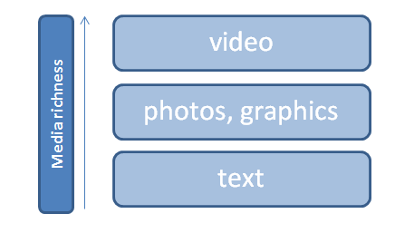
Visuality
The disclosure literature highlights the importance of the medium with which the information is presented.
Previous research (Cho et al. 2009; Graves et al. 1996) points out that text disclosure alone is no longer adequate to articulate information.
According to Davison (2007), having simple pictures in annual reports affects the perception of richness and potency of the message.
Thus, the accounting scholars point out the importance of visual imagery such as graphics, photos, and pictures, stressing that these are more powerful communication tools that affect the viewer’s perception and potency of a message.

Slide 13
Technological elements
The rapidly changing business environment is forcing companies to adapt quickly and consider the most effective ways of communication and reporting.
The Internet enables companies to reach wider audiences and various groups of stakeholders, moreover, it is cost saving and facilitates timely information disclosure (Koreto, 1997; Jones et al. 1998).
The evolution of Web 2.0 has brought even more flexibility and facilities for companies seeking the transparency and stakeholder engagement especially due to the massive spread of social media such as Facebook, Twitter, LinkedIn, YouTube, etc..
Information and transformation function of IR (Serafeim and Eccles, 2014)
Therefore, recent sophisticated technologies enable companies to enhance their corporate presence. Indeed, incorporating different social networking sites or other technological features such as QR codes into the IR, might improve the user`s experience with the report as this is being perceived more efficient and interactive.

Slide 14
Business model
The IIRC points out the seven key elements of the IR, which are organizational overview and external environment; governance; business model; risks and opportunities; strategy and resource allocation; performance; outlook; and basis of presentation (IIRC, 2013).
Nevertheless, the main emphasis is put on the business model which should provide the description of how the company manage to create and sustain value over time. It includes a description of the key inputs, business activities, outputs and outcomes.
Also the EU Communication (2017) in their guidelines for sustainability reporting points out the importance of this concept.
Thus, a comprehensive description of the business model can be considered a central point of the integrated report.

Slide 15

Methodology
IBEX 35 companies – a comparative analysis of the quality of the IR (2016 - 2019)
In 2019 the listed companies in Spain have to follow the new regulation related to the sustainability reporting – did it affect the quality of the reports ?
We developed an index and measured scoring for visuality, navigability, description of the business model, and technological elements to assess user’s experience while using the report.

Slide 16
Index development
Criteria | Evaluation | Description
Easy navigability (conciseness) | 5 | Navigation chart
 | 4 | Clickable internal links within a report
 | 3 | No internal links, but the report has less than 180 pages
 | 2 | 180-360 pages
 | 1 | More than 300 pages, no internal links

Slide 17
Criteria | Evaluation | Description
Visuality | 5 | High usage of visual elements (charts, photos, etc.), proportion is approximately 1:1 or more
 | 3 | Moderate usage of visual elements
 | 1 | Mostly narrative character

Slide 18
Criteria | Points | Description
Technological elements (1 point for each element a-e) | 5 elements | a) navigation chart type of the IR
 | 4 elements | b) External links
 | 3 elements | c) videos
 | 2 elements | d) Links to SNs
 | 1 element | e) QR codes

Slide 19
Criteria | Evaluation | Description
Business model (as a key element of IR) | 5 | The IR includes all the elements below: Features that can enhance the effectiveness and readability of the description of the business model include: • Explicit identification of the key elements of the business model • A simple diagram highlighting key elements, supported by a clear explanation of the relevance of those elements to the organization • Narrative flow that is logical given the particular circumstances of the organization • Identification of critical stakeholder and other (e.g., raw material) dependencies and important factors affecting the external environment • Connection to information covered by other Content Elements, such as strategy, risks and opportunities, and performance (including KPIs and financial considerations, like cost containment and revenues).
 | 3 | The company introduces the key elements of the business model, however, some details mentioned above might be omitted.
 | 1 | The information about the business model is rather scarce.

Slide 20

Findings

Slide 21
Statistical analysis - Mann-Whitney test
Sector (critical vs. non-critical) and Quality Reporting Index
Findings
In 2016, companies operating in critical sector tend to have higher quality reporting index (p-value – 0.039).
In 2019, there is no significant difference between the two groups.

Slide 22
Findings
More companies are using some form of the IR
Average number of pages increased from 180 pages (2016) to 250 pages (2019)
13 companies worsened the quality of the report
4 companies maintained it
11 companies improved the quality of the report
Enagas, great improvement, particularly in easy navigability, technological elements and business model description.
7 new companies, which started with IR in 2019 show medium or low quality (average score was 7 points out of 20)

Slide 23

Conclusions
Quantity for the sake of quality - Increased number of IRs (those are also getting longer).
Companies try to comply with the new regulation (WHAT?) by providing more information but rather neglect the user’s experience (HOW?) in using the report.
One of the principles of the IR – conciseness - is not being applied.
”putting together” vs. “integrated” – misconception on the side of managers
The final experience of the report user to gain his trust and perception of usefulness should not be forgotten.

Slide 24
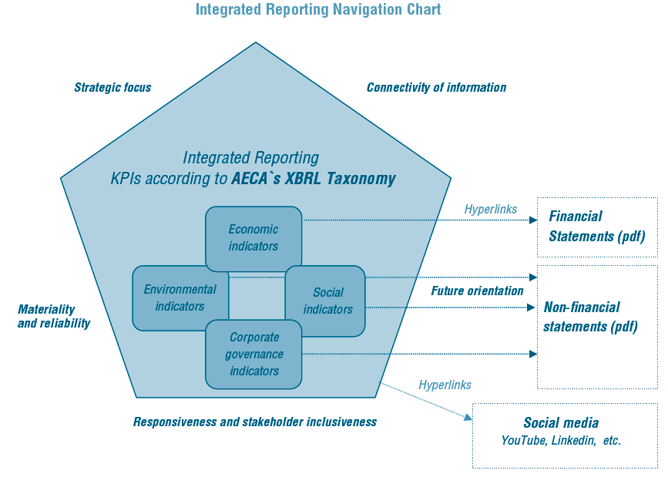

Slide 25
Conclusions - regulation
general public support regarding the regulations related to the sustainability
For the companies: more bureaucracy which can be burdensome
costs of regulation are never “absorbed” by businesses, but they always fall on the final consumer (Beales et al., 2017).
regulation in terms of sustainability disclosure by large corporations can be critically important to improvements in environmental quality (clean air and water), fair trade, social welfare (non-discrimination, etc.).
BUT poorly designed regulation -> counterproductive : lower quality of such disclosure, greenwashing, or unnecesarily increasing the costs for companies.

Slide 26
Thank you for your attention ☺

